Slide 1

Introduction to Dart

Slide 2
About Dart:
Dart is open-source.
It was originally developed by Google in 2011.
Dart is a new programming language meant for the server as well as the browser.
Dart is an object-oriented language with C-style syntax.
developing fast apps on any platform(cross-platform).
Dart also forms the foundation of Flutter

Slide 3
Why use Dart in Flutter
Here is a quick list of the Dart features that together make it indispensable for Flutter:
Dart is AOT (Ahead Of Time) compiled to fast, predictable, native code, which allows almost all of Flutter to be written in Dart. This not only makes Flutter fast, virtually everything (including all the widgets) can be customized.
Dart can also be JIT (Just In Time) compiled for exceptionally fast development cycles and game-changing workflow (including Flutter’s popular sub-second stateful hot reload).

Slide 4
Why use Dart in Flutter (Cont.)
Dart makes it easier to create smooth animations and transitions that run at 60fps.
Dart allows Flutter to avoid the need for a separate declarative layout language like JSX or XML, or separate visual interface builders, because Dart’s declarative, programmatic layout is easy to read and visualize. And with all the layout in one language and in one place, it is easy for Flutter to provide advanced tooling that makes layout a snap.

Slide 5

Importance of Flutter
Flutter has gained significant importance in mobile app development due to its unique features and advantages. Here are some reasons why Flutter is important:
Single Codebase, Multiple Platforms: Flutter allows you to develop applications for multiple platforms (iOS, Android, web, desktop) using a single codebase. This reduces development time and effort, as developers don’t have to maintain separate codebases for different platforms.
Hot Reload: Flutter’s hot reload feature enables developers to see changes in real-time as they code, without restarting the app. This speeds up the development process and facilitates experimentation and quick bug fixing.
Rich UI: Flutter offers a rich set of customizable widgets that help create visually appealing and consistent user interfaces across platforms. These widgets can be customized to match the platform’s design guidelines or your own unique brand style.

Slide 6
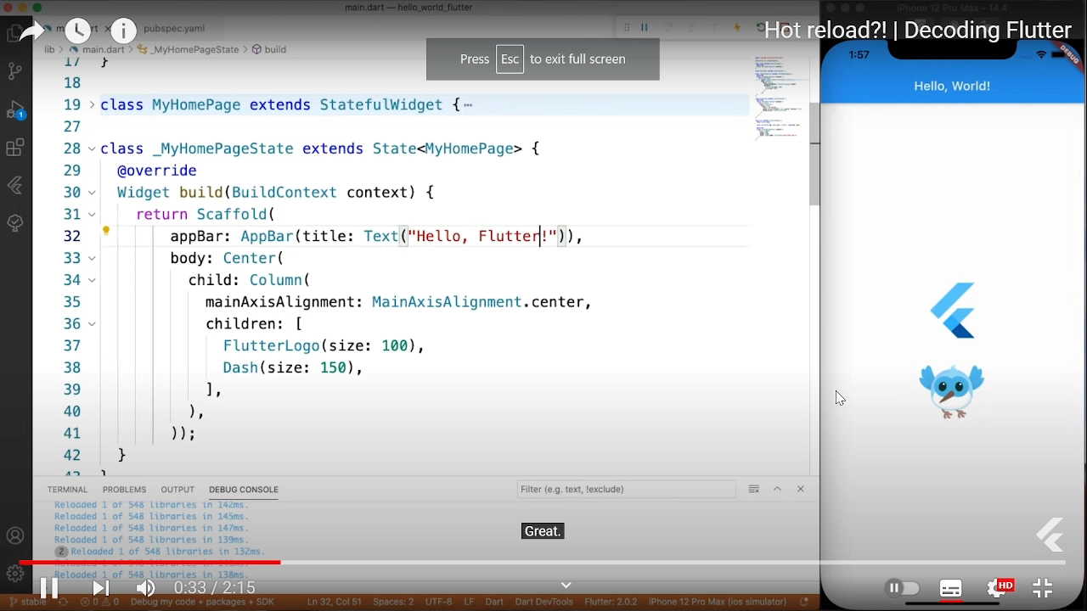

Slide 7
Importance of Flutter (Cont.)
4. Performance: Flutter’s architecture allows it to achieve high-performance levels. It uses a compiled programming language (Dart) and doesn’t rely on a bridge to communicate with the native modules, resulting in faster app execution and reduced performance bottlenecks.
5. Access to Native Features: Flutter provides plugins and packages that grant access to device-specific features and native APIs. This means you can integrate camera, GPS, sensors, and more without leaving the Flutter environment.
6. Open Source and Active Community: Flutter is an open-source framework backed by Google. Its active community contributes to its growth, stability, and availability of third-party packages, which extend its functionality.
7. Reduced Development Time and Cost: Since you’re working with a single codebase and the hot reload feature, development time is significantly reduced, which translates to lower development costs.

Slide 8
Dart Installation
To learn the Dart, we need to set up the Dart programming environment on our local machine. We are describing the following instructions to install the Dart SDK (Software Development Kit).
If you have already installed it, then you can skip this part.

Slide 9
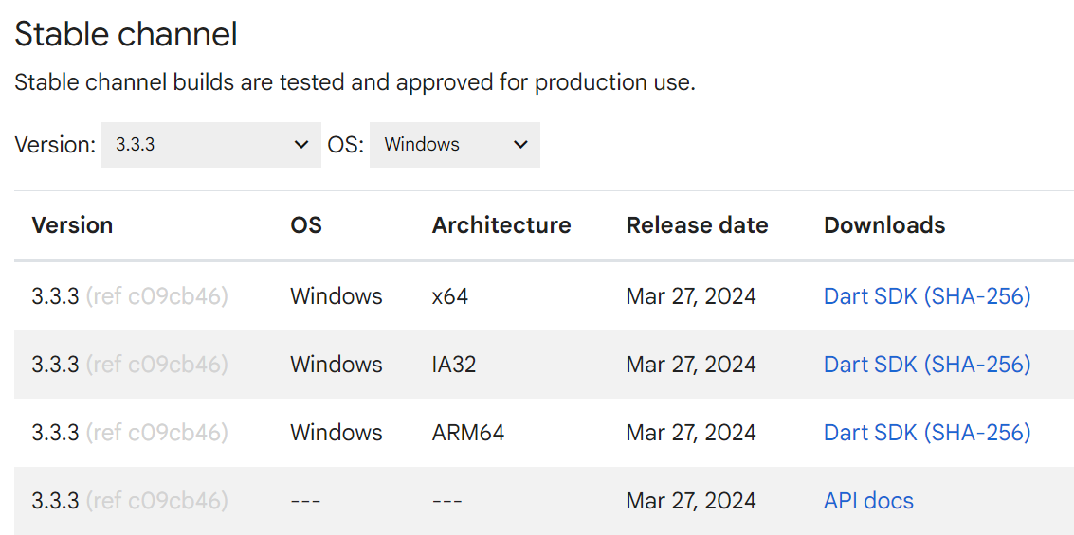
Install the Dart SDK on Windows
Follow the below instructions to install Dark SDK in Windows.
Step -1: Go to the browser and type the following link to download the SDK. https://dart.dev/get-dart/archive.
It will open the given page, Choose the suitable architecture for your device.
Move SDK folder to C drive (optional)
Then, we need IDE to write code
Step - 2: Download VSC (visual studio code) on your PC.
Step - 3: Install ‘Dart’ extension in VSC.
Congratulations! Dart SDK installed successfully 🎉

Slide 10
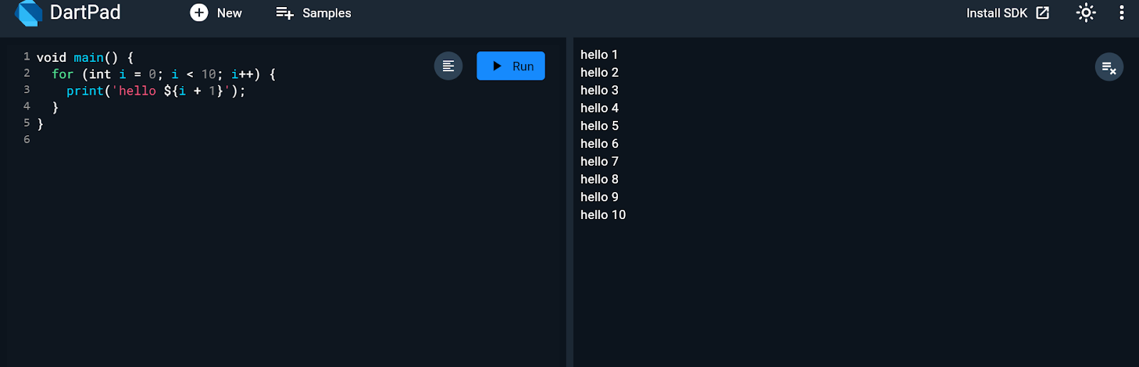
Online Dart Editor
If we do not want to install Dart then there is an online Dart editor (Known as DartPad) available to run the Dart programs.
The online DartPad is provided at https://dartpad.dev/.
The DartPad offers to execute the dart scripts and display HTML and also console output. The online DartPad looks like the below image.

Slide 11
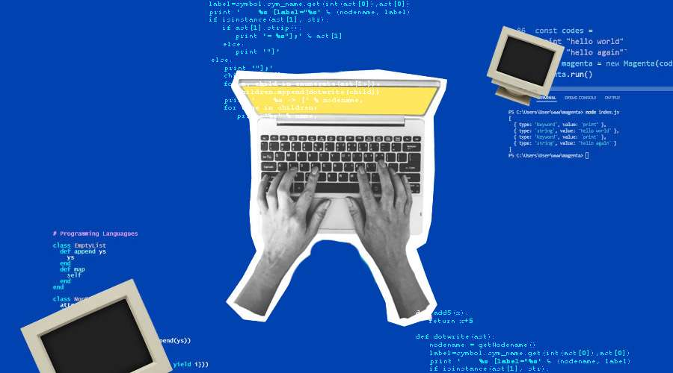
First program in Dart

